Slide 1
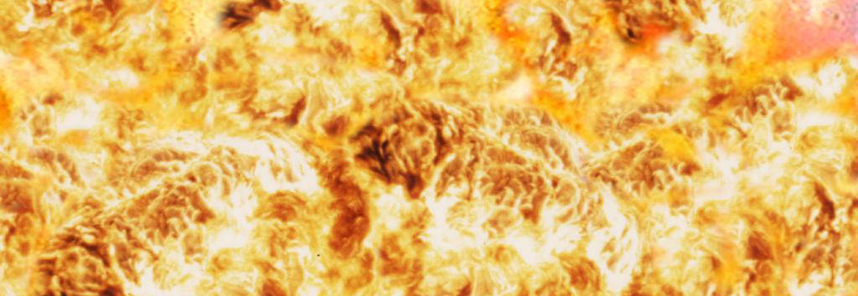
Safety Aspects for Solid Fuel Grinding
Technical Development Program for Process Performance Engineers

Slide 2
Difference between coal and raw grinding?
Similar fineness range – R90μm = 3% up to 20%
Similar grindability – about 10 kWh/t (vertical roller mill)
Similar moisture range – 5% up to 25%
BUT…
Raw meal is non-combustible

Slide 3
Raw Coal Storage
Raw coal storage
Anthracite and petcoke < 15% VM generally do not ignite spontaneously even after prolonged storage
Height of coal piles
> 10 m: Anthracite and petcoke < 15 % VM
6 - 10 m: Coal with 15 – 30 % VM
4 - 8 m: Coal > 30 % VM
Recommended storage time
4 months: Petcoke and anthracite coals < 13% VM
2 - 3 months: Bituminous coals with 14 - 35% VM
1 - 2 months: Sub-bituminous coals with 36 to 45% VM

Slide 4
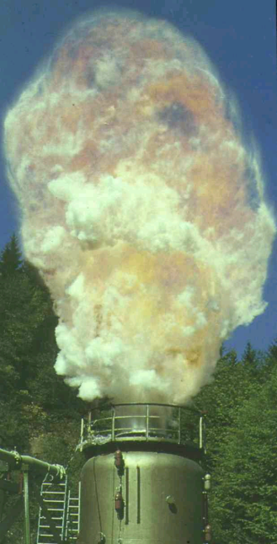
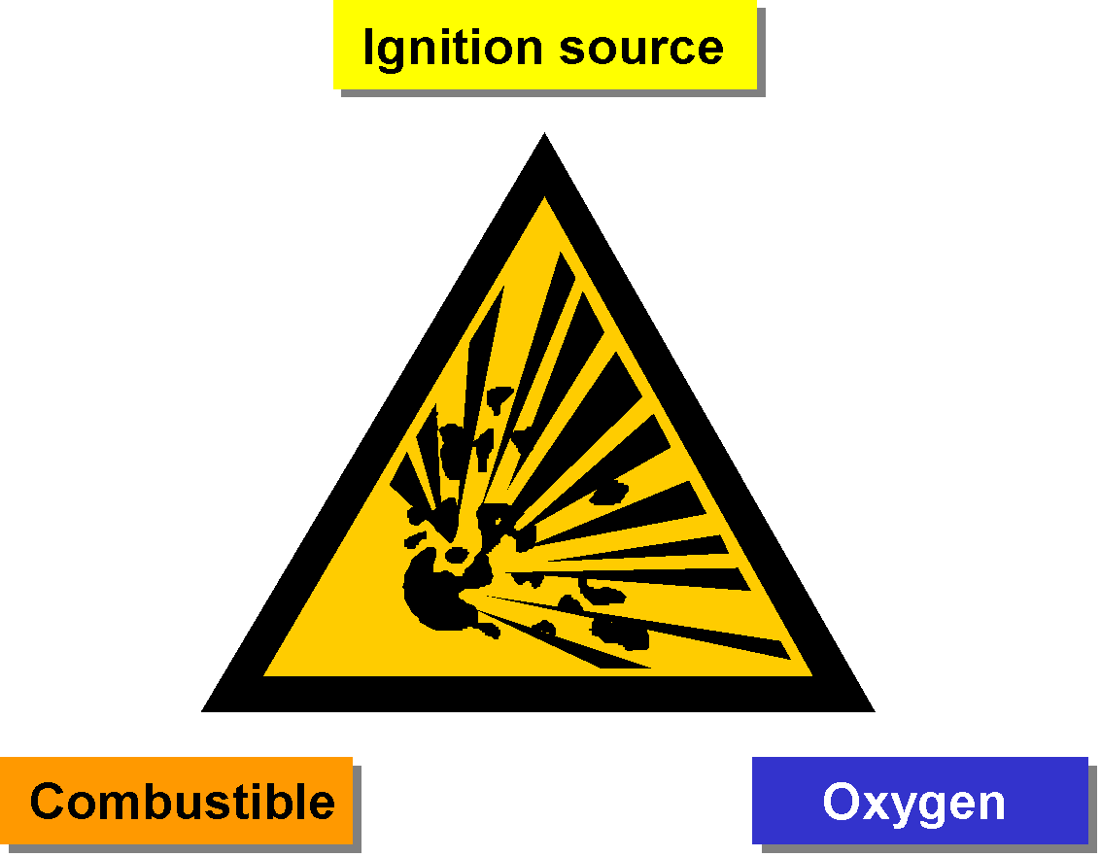
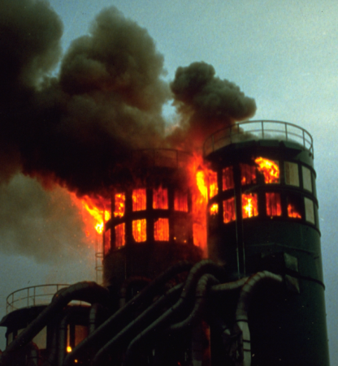
What we do not want…

Slide 5
Safety aspects for solid fuel grinding - Outline
Solid fuels
Properties of solid fuels
Classification of coals
Development of dust explosions and fires
Characterization of dust explosions
Explosion limits
Explosion protection
Active or preventive explosion protection
Passive or constructive explosion protection
Key message

Slide 6
What are solid fuels?
Solid fuels
Any traditional fuel in solid state
In most cases to be pulverized before use
Groups of solid fuels
Coal
Fossil fuel consisting of carbonized vegetable matter deposited in the Carboniferous
Low rank coal, Powder River Basin (PRB) coal, lignite
“Young” coal of the Tertiary with a low grade of coalification, high volatiles, low calorific value and high moisture
Petcoke
By-product of the petroleum refining process

Slide 7
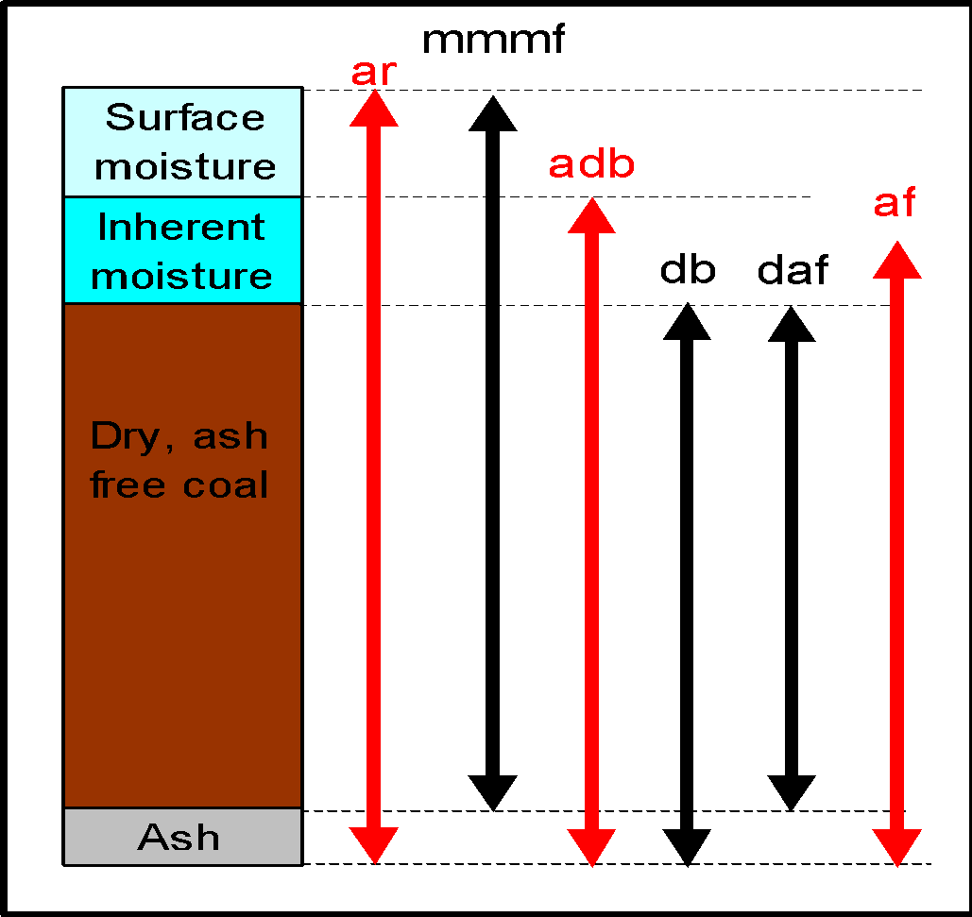
Calorific value – many reference options
Used moisture definitions:
As received basis (ar)
Moist, mineral matter free basis (mmmf)
As determined basis (air-dried basis, adb)
Dry basis (db)
Dry ash free basis (mineral matter free basis, daf)
As fired (af)
When using the CV – make sure what is the reference

Slide 8
Safety aspects for solid fuel grinding
Solid fuels
Properties of solid fuels
Classification of coals
Development of dust explosions and fires
Characterization of dust explosions
Explosion limits
Explosion protection
Active or preventive explosion protection
Passive or constructive explosion protection
Key message

Slide 9
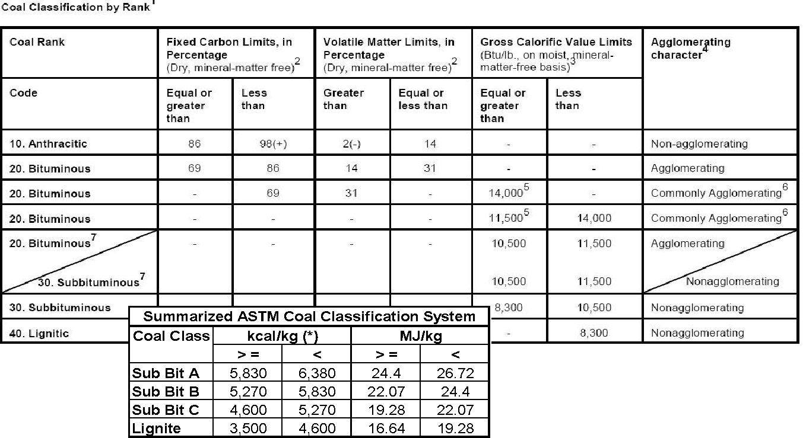
Coal classification by rank

Slide 10
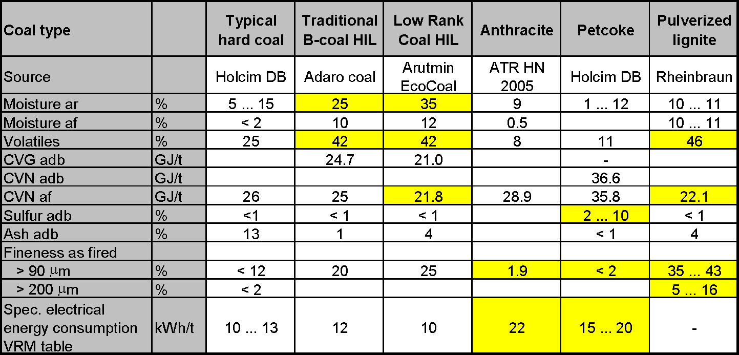
Short overview of relevant coal properties
Yellow marked figures: Relevant data for dimensioning

Slide 11
Safety aspects for solid fuel grinding - Outline
Solid fuels
Properties of solid fuels
Classification of coals
Development of dust explosions and fires
Characterization of dust explosions
Explosion limits
Explosion protection
Active or preventive explosion protection
Passive or constructive explosion protection
Key message

Slide 12
When do we have to expect an explosion?
Conditions for explosions
Stirred-up, combustible dust present in explosive concentration
Air or oxygen above the critical concentration, for coal dust as a rule, above 14%
An ignition source possessing energy above the minimal ignition energy (depending upon the type of dust)
Ignition source
Ignition source
Combustible
Oxygen
Combustble
Oxygen

Slide 13
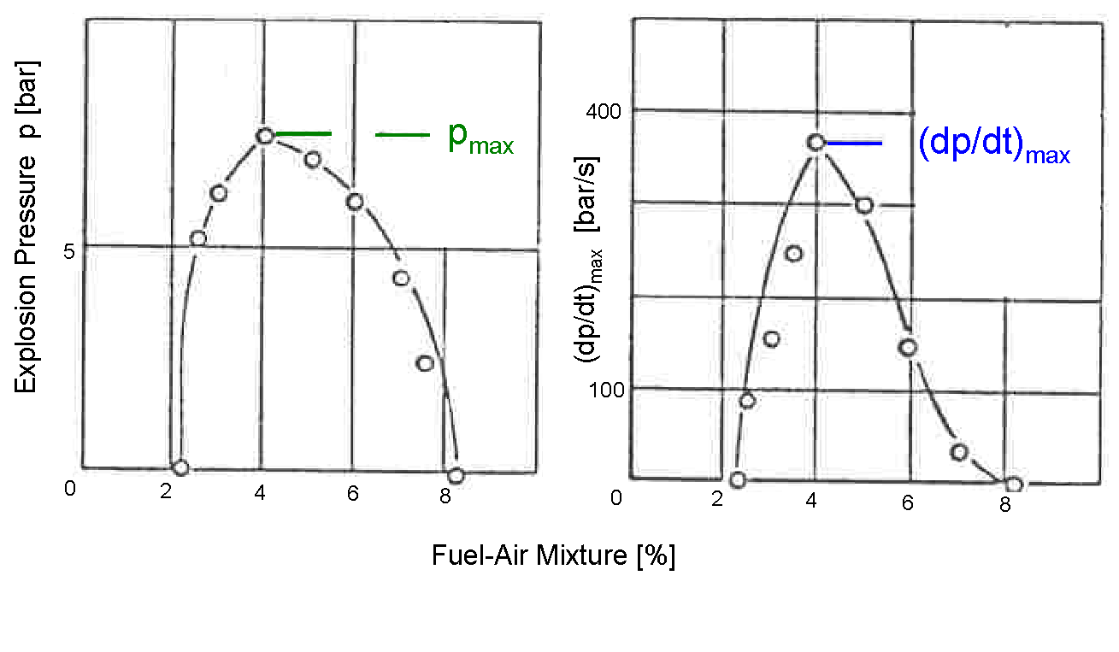
Explosive atmosphere and explosion limits
Lower Explosion Limit (LEL):
Below LEL fuel-air-mixtures are too lean to explode
Upper Explosion Limit (UEL)
Above UEL fuel-air-mixtures are too rich to explode
Explosive Atmosphere
LEL
UEL

Slide 14
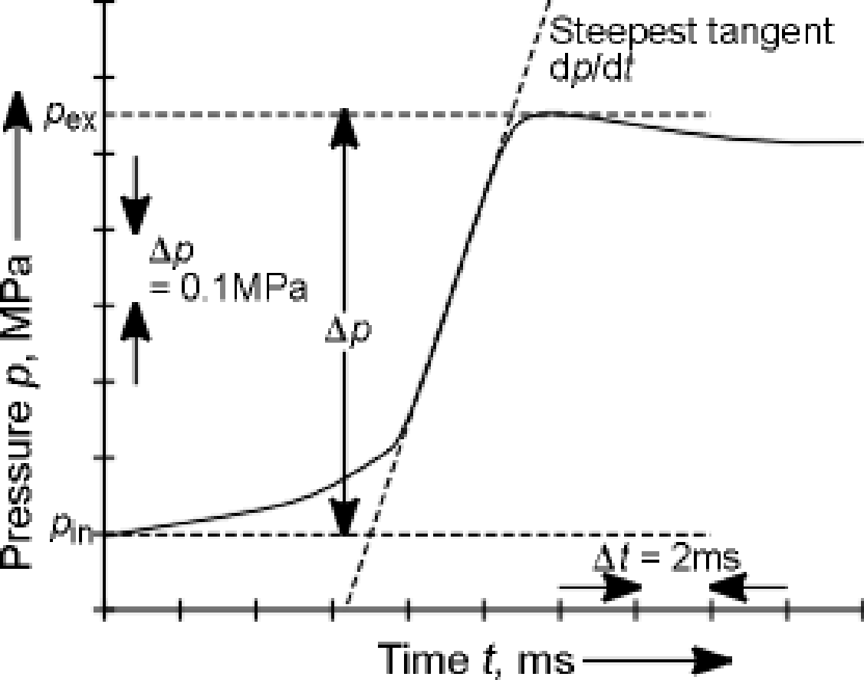
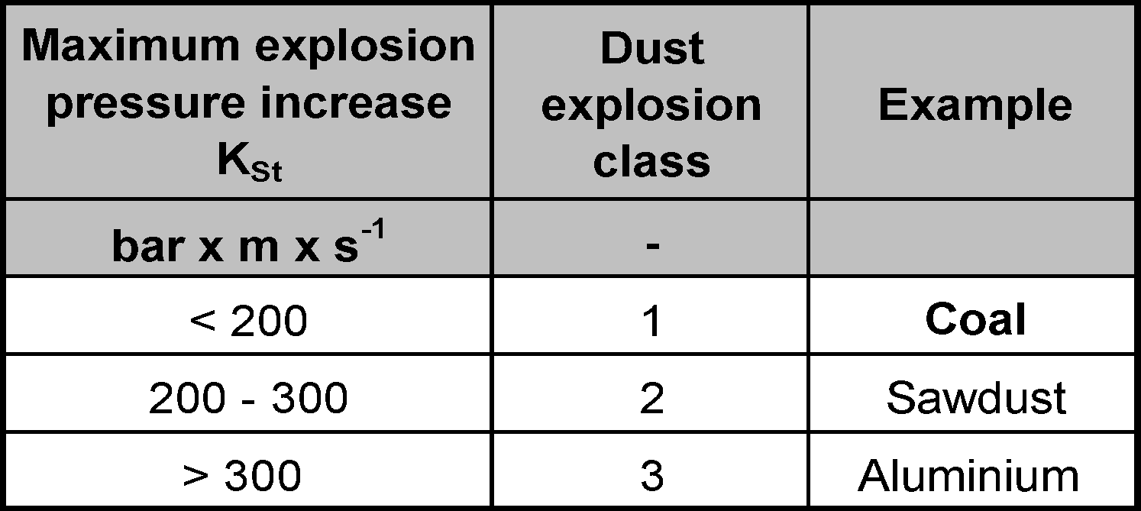
Characterizing explosions - Dust explosion classes
Typical explosion process
Δp: explosion overpressure
p_{ex}: maximum explosion pressure
dp/dt: maximum rate of pressure rise or explosion coefficient K_{st}
Dust explosion classes

Slide 15
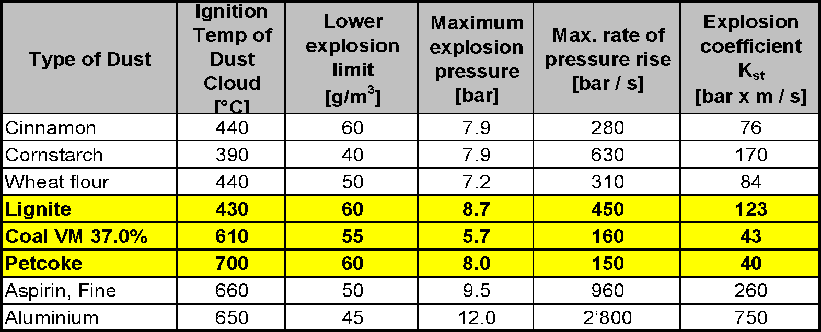
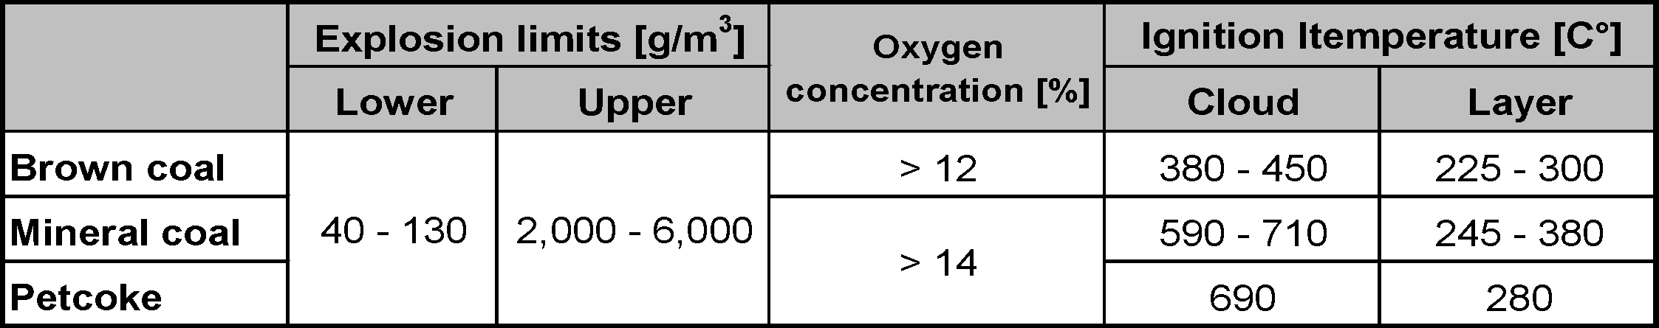
Explosion parameters and limits
Explosion parameters (examples)
Explosion limits

Slide 16
Safety aspects for solid fuel grinding
Solid fuels
Properties of solid fuels
Classification of coals
Development of dust explosions and fires
Characterization of dust explosions
Explosion limits
Explosion protection
Active or preventive explosion protection
Passive or constructive explosion protection
Key message

Slide 17
Explosion protection – what can be done?
Two different approaches:
Active or preventive explosion protection
“What can be done to prevent dust explosions?”
Passive or constructive explosion protection
“A dust explosion can happen any time - what can be done to minimize its impact to people and equipment?”

Slide 18
Active or preventive explosion protection
Key question: What can be done to prevent dust explosions?
Inert operation with kiln exit gases
Inlet and outlet temperature control
Monitoring temperatures and CO
Inertization with CO₂ or N₂
Design criteria and ATEX-Zoning
Organization and training of all people involved

Slide 19
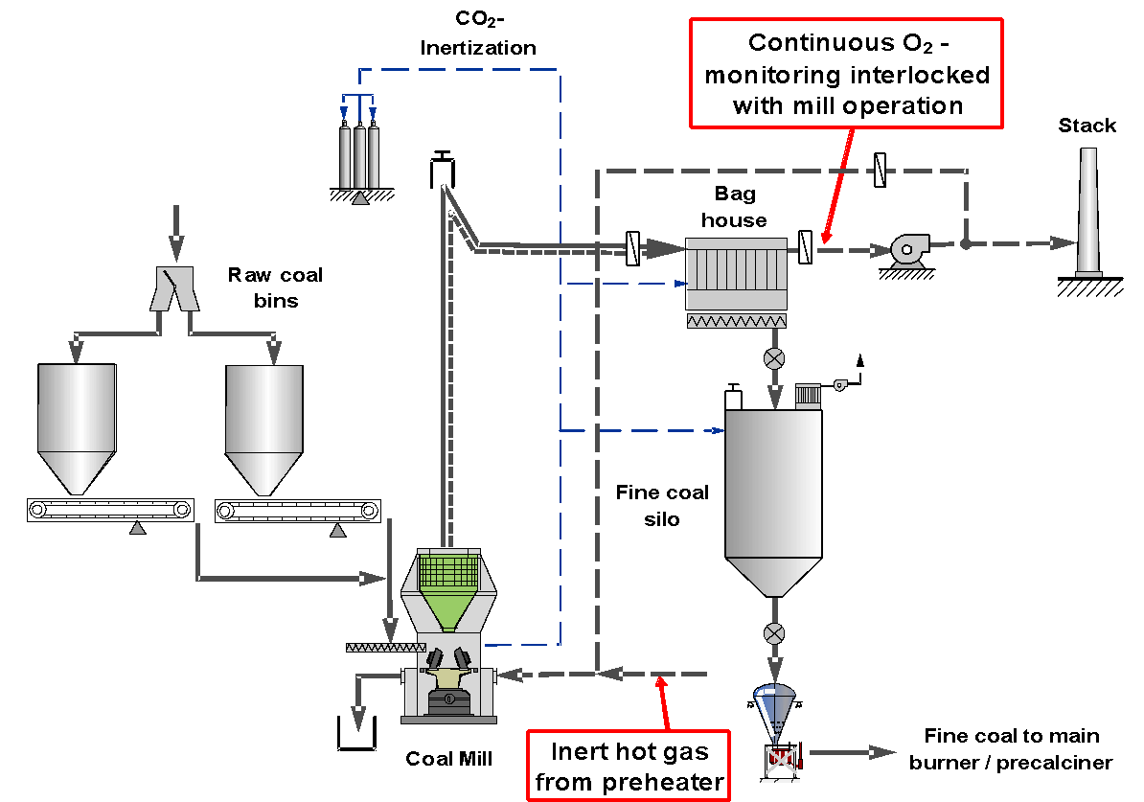
Active explosion protection – Inert operation

Slide 20
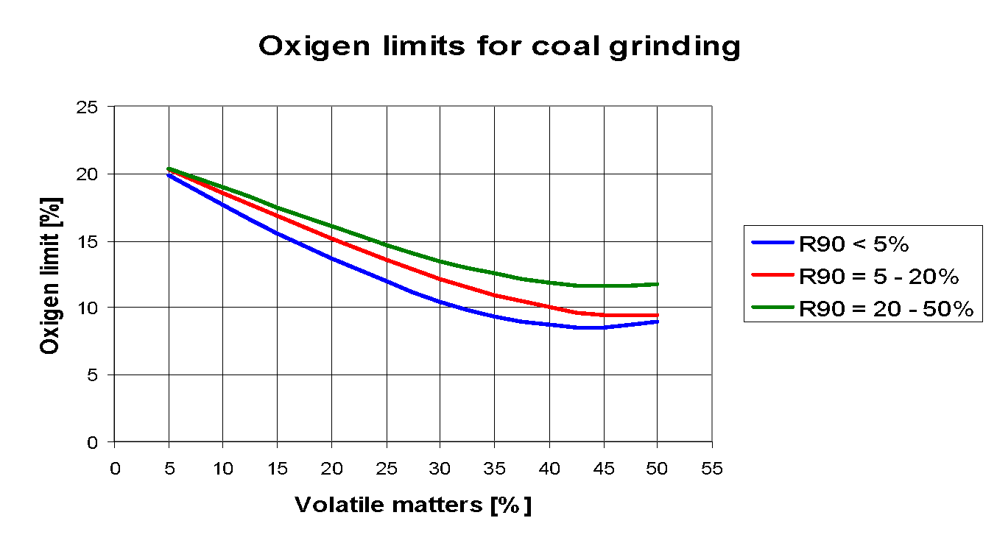
What means inert operation?
Operation of the coal mill in an inert atmosphere
The oxygen limit depends on VM and product fineness
Do not mix up with inertization!
HTEC recommendation:
Keep the oxygen limit 2% below the technical limit!
< 12% oxygen after bag house for petcoke and coal
< 10% oxygen after bag house for lignite and low rank coal

Slide 21
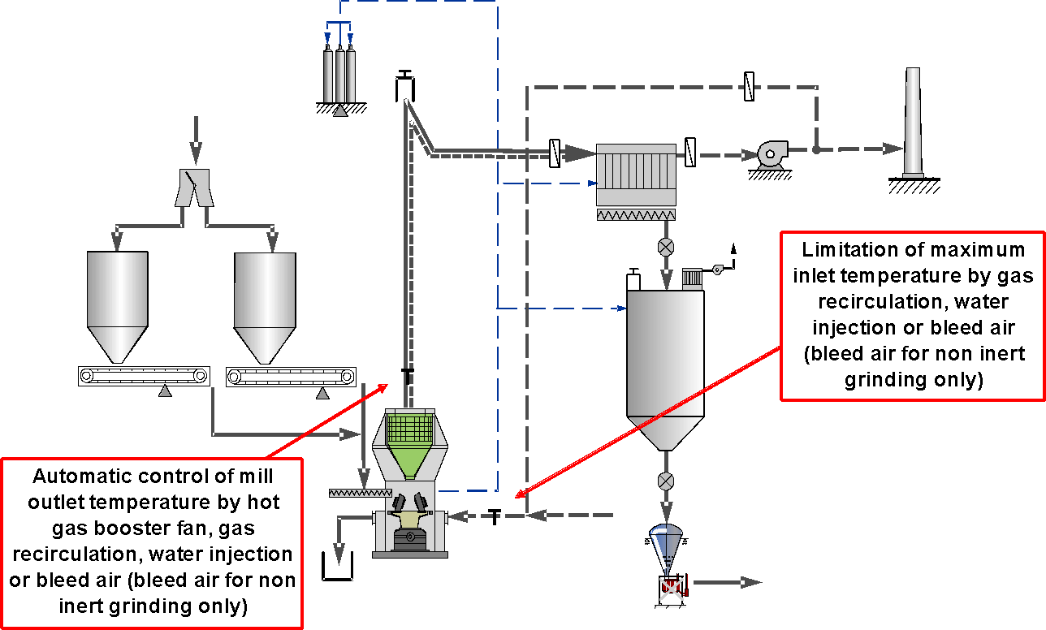
Active explosion protection – Temperature control

Slide 22
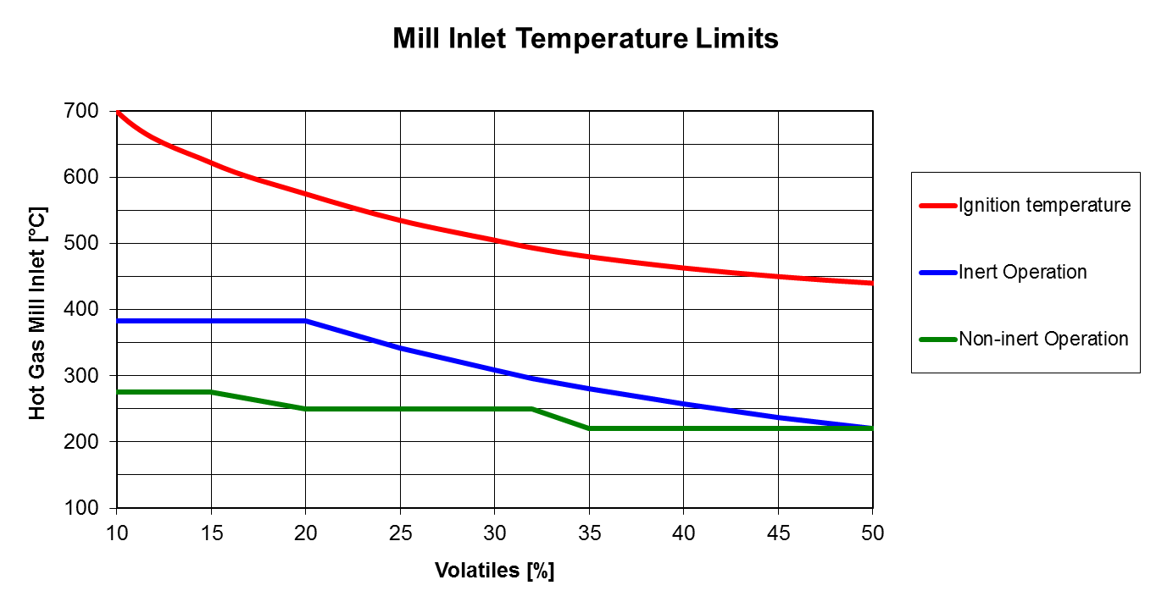
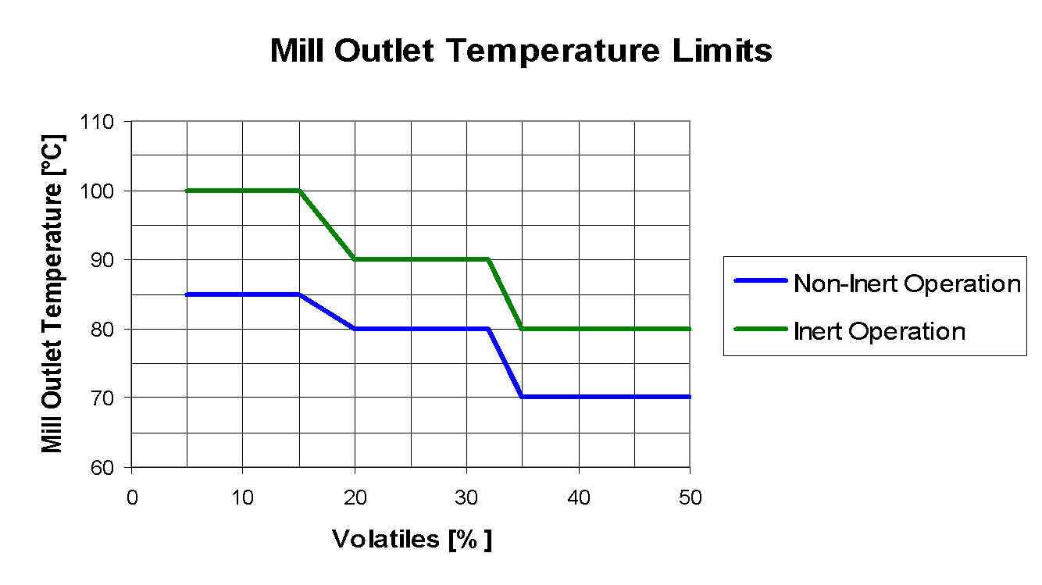
Recommended inlet/outlet temperature limits

Slide 23
Recommended inlet/outlet temperature limits
SN | Process safety parameters | LH Guideline | Alarm | Tripping
1 | Mill inlet Temp , Deg C | 275
2 | Mill Outlet Temp, Deg C | 80
3 | Bag Filter Temp diff , Deg C | 10
4 | BH Hopper Temp, Deg C | 115
5 | Fine Coal Bin Temp, Deg C | 90
6 | Raw Coal hopper Temp, Deg c | 55
7 | Bag Filter Inlet C0,ppm | 1500
8 | Bag Filter out let C0,ppm | 1500
9 | Fine Coal Bin C0, ppm | 1500

Slide 24
Sensor calibration schedule
SN | Process safety parameters | Schedule
1 | Mill inlet/outlet Temp | 12M
2 | Bag Filter Hopper Temp (3 Nos) | 12M
3 | Fine coal Bin Temp (4 Bins) | 12M
4 | Bag Filter C0/02 Analyzer (1 ) | 6M

Slide 25
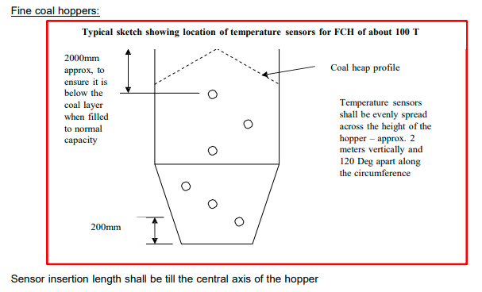
Positioning of sensor at fine coal bin

Slide 26
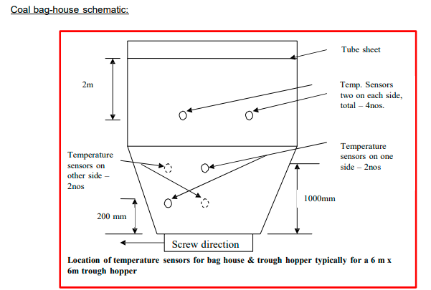
Bag House sensor positioning

Slide 27
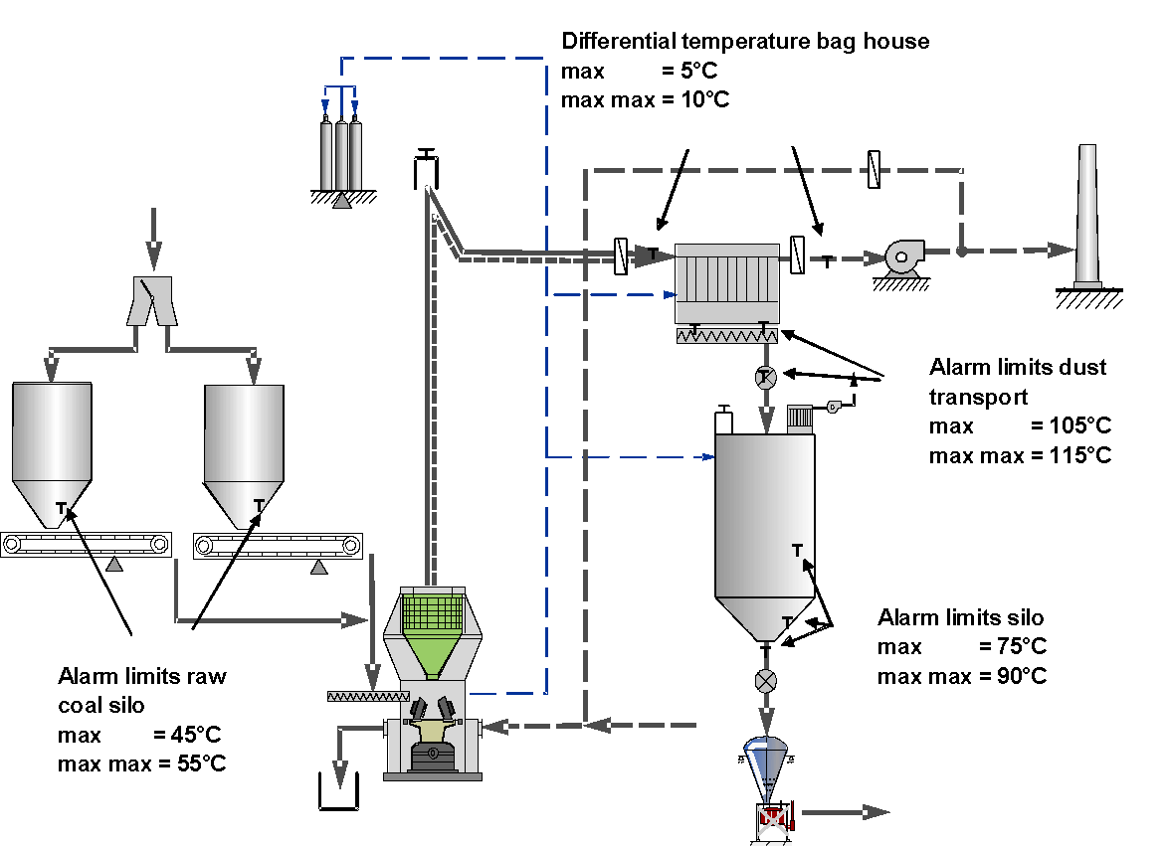
Active explosion protection – Temperature monitoring
Temperature as indicator for smoldering fires
Continuous temperature measurement with automatic interlocks

Slide 28
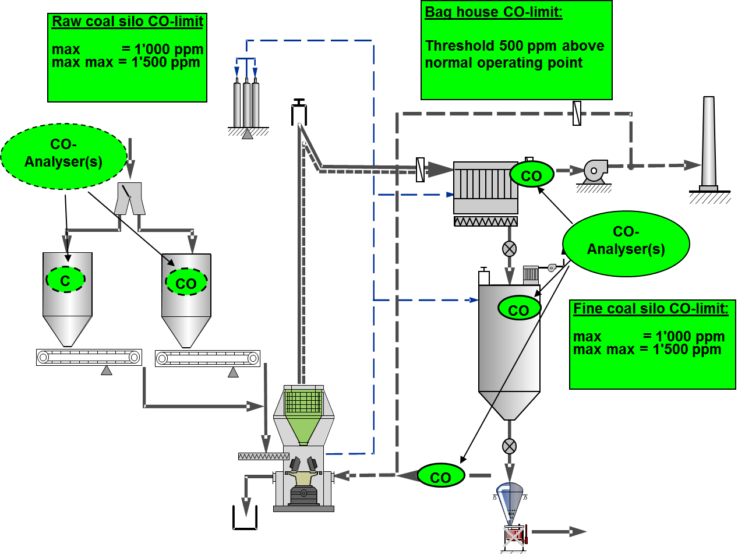
Active explosion protection – CO monitoring
CO-increase as quick indicator for smoldering fires
Continuous measurement of the CO concentrations with automatic interlocks

Slide 29
Active explosion protection – Inertization
Automatic inertization of equipment in case of an incident detected by sensors (previously defined)
Inerting installation with following characteristics:
Injection of CO₂ gas
2 kg CO₂ per m³ for inerting (mill, cyclone, bag house, ducts, silos)
60 minutes inerting time for each section. The flow should be checked.
Required storage capacity > 4 kg CO₂ per m³ in total for inerting (in general a tank of 5 - 10 t capacity).

Slide 30
Mill Intertisation Calculation
CO2 gas volume calculation guidelines:
Coal Bag house fires are considered as deep seated fires and as per NFPA-12 standards for deep seated fires the following are the guidelines:
Total CO2 gas quantity required in kg = Volume of the equipment x 2.66 (Flooding factor)
Number of CO2 cylinders required = CO2 gas quantity in kg/ Capacity of one cylinder
Initial discharge quantity of CO2 gas = Volume of equipment X 1
(to achieve a design concentration of 30% i.e. to reduce O2 to < 15%.
Time for initial discharge = 2 minutes maximum

Slide 31
Calculation
Extended discharge quantity of CO2 gas = Total CO2 gas quantity required – Initial discharge quantity (to achieve a design concentration of 75% i.e. to reduce O2 to about 5-6%)
Time for extended discharge quantity of CO2 gas = 7 minutes
The concentration of CO2 gas shall be maintained for 20 minutes
The rate of discharge shall be controlled by orifices provided in the pipelines.
Example: For a volume of 300 m3, requirement is 300 x 2.66 = 798 kg No of cylinders required = 798/45 (capacity of one cylinder) = 18 cylinders Initial Discharge = 300 x 1= 300kg = 7 cylinders of 45 kg to be discharged in 2 minutes (30 %) Extended Discharge = 798 – 300 = 498 kg; 11 cylinders of 45 kg to be discharged over 7 minutes. The CO2 concentration shall be maintained for 20 minutes

Slide 32
Active explosion protection – Design and organization
Holcim Design Critereria for coal grinding available in the Intranet
Manual “Solid Fuel Preparation – Basic Safety Aspects for Solid Fuel Storage, Handling and Grinding” available on Google-Hub
Continuous instead of intermittent coal mill operation to minimize frequency of mill stops
SOPs for mill operation and mill safety
Regular training of all involved people
Systematic testing of safety relevant sensors and interlocks
Good documentation of the entire grinding system

Slide 33
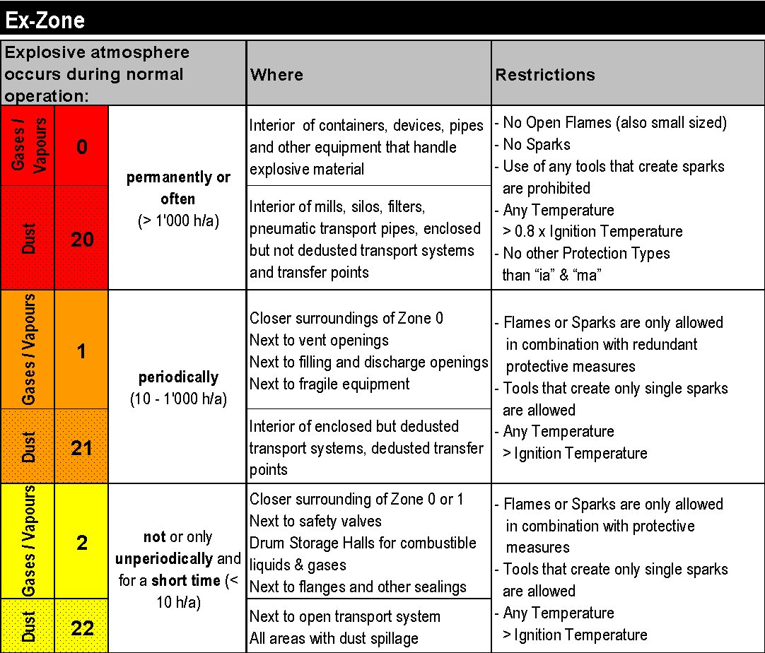
Active explosion protection – ATEX-Zoning
Definition of ATEX zones 20, 21 and 22 for different areas
The zones characterize the potential hazard
The zones have to be equipped with authorized mechanical and electrical installations only

Slide 34
Passive or constructive explosion protection
Key question: What can be done to minimize the effect of dust explosions?
Passive explosion protection measures do not prevent explosions
Designed to withstand explosion pressure shocks up to the maximum pressure increase
Designed to withstand explosion pressure shocks up to the reduced maximum explosion pressure (pressure relief devices)

Slide 35
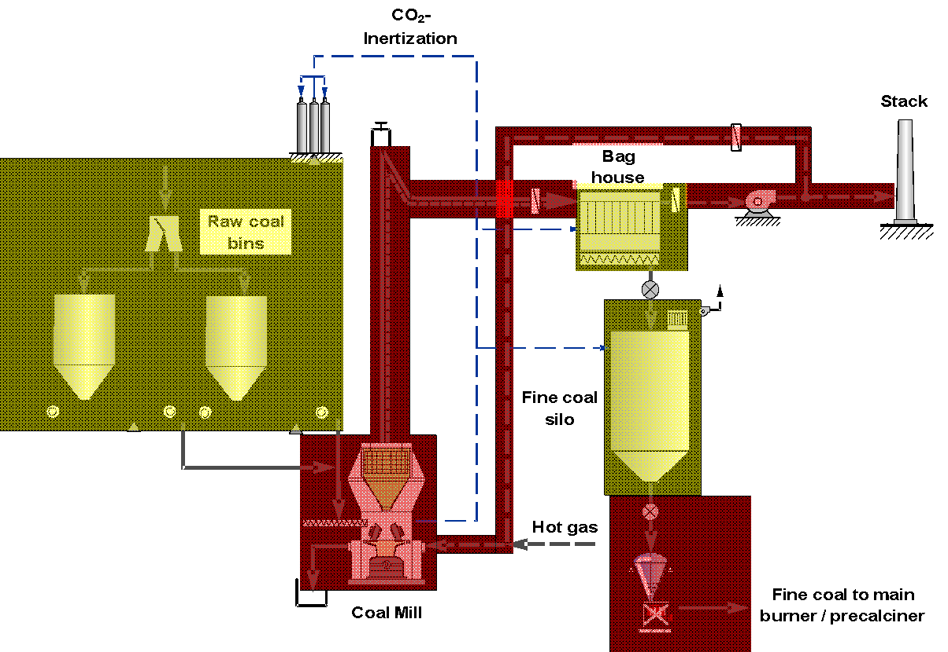
Simplified passive explosion protection layout
Explosion pressure resistant
Reduced explosion pressure vented

Slide 36
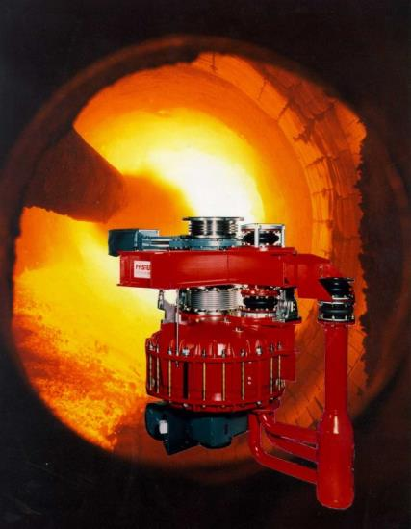
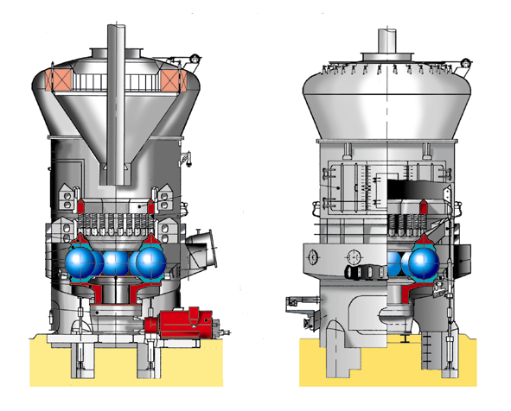
Passive explosion protection – Pressure resistance
Pressure resistant equipment in some areas standard
Vertical mills
Feeder systems
Ducts

Slide 37
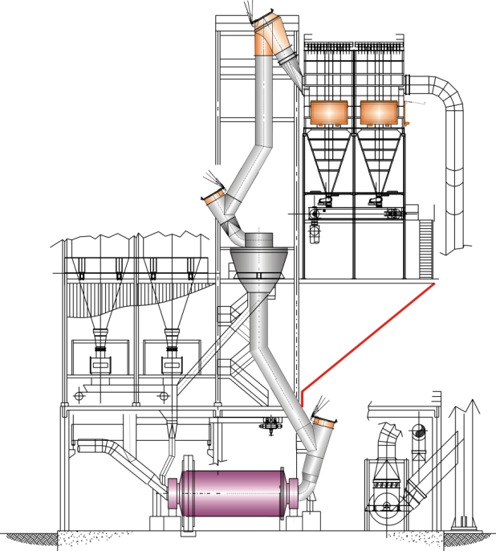
Passive explosion protection – Pressure venting
Pressure venting measures for more complicated areas
Silos
Filters
Separators
…

Slide 38
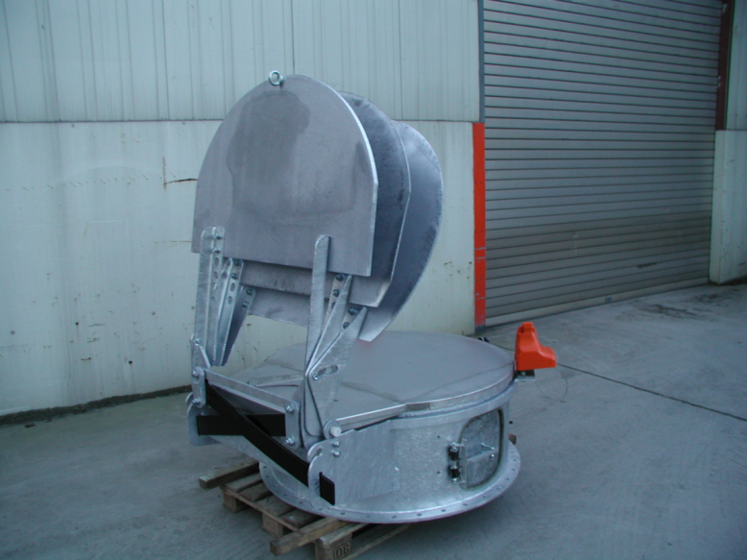
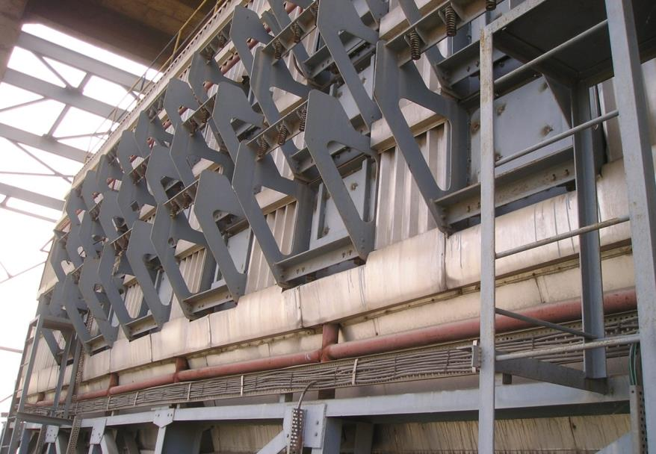
Passive explosion protection – Pressure vents
Pressure vent for large ducts
Pressure vents for bag houses

Slide 39
Safety aspects for solid fuel grinding
Solid fuels
Properties of solid fuels
Classification of coals
Development of dust explosions and fires
Characterization of dust explosions
Explosion limits
Explosion protection
Active or preventive explosion protection
Passive or constructive explosion protection
Key message

Slide 40
Key Message
Do never underestimate the explosion risk related to combustible dusts.
You can grind many solid fuels – never forget the safety concept and its realization.
Design safety has a substantial impact on the investment costs.
Take advantage of the LafarageHolcim knowledge and do your best to avoid dust explosions
A safety concept doesn’t only include technical items - but also the organization.

